Slide 1
物聯網結合AI在魚類之應用
組員:吳承威、王樸
指導教授:林政宏

Slide 2
With respect to the GUI

Slide 3
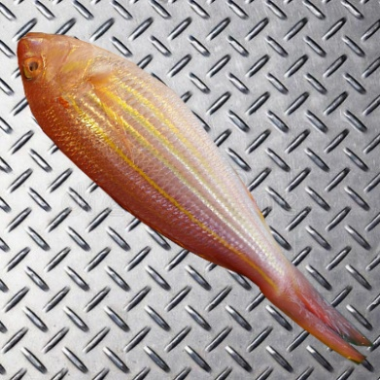
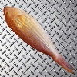
Can send photo to the server
Images will be resized to a size smaller that 100x100
Then this is saved to a json file and sent to the server
Demo.json
Filename | Id | Name (of the fish) | Length (of the fish) | Image (string of rgb pixels brightness) | Size (size of the image)
Fish.jpg | 1 | Nemipterus_virgatus | 98 | [0,125,……….,255,61] | WxHxC

Slide 4
Once in server
Image will be save in a new directory called static, the image will maintain is original name
A new file be created that only contain important things, which will be part of the data base
Demo.csv
Filename () | Id | Name (of the fish) | Length (of the fish)
…/static/Fish.jpg | 1 | Nemipterus_virgatus | 98

Slide 5
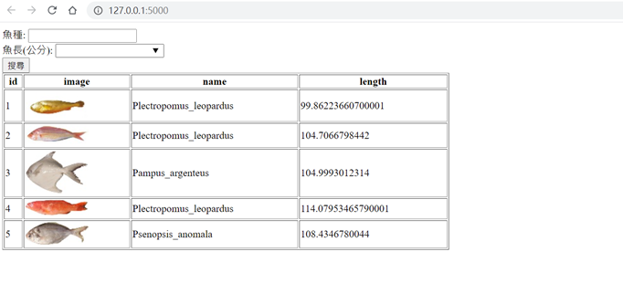
網頁呈現

Slide 6
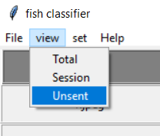
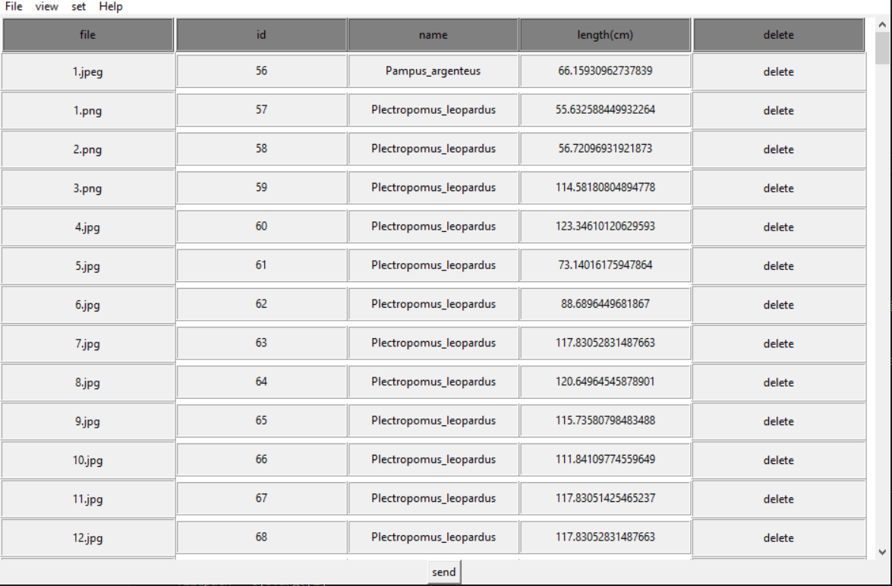
If the server is not connected
Save data in another csv. Which can be sent to server when any moment if the server is connected

Slide 7
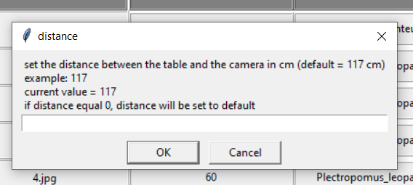
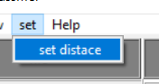
also
Add a function that let me set the distance between the camera and the object
If the camera don’t work properly at certain distance or don’t have the space, there is an option to change it

Slide 8
With respect to the neural network

Slide 9
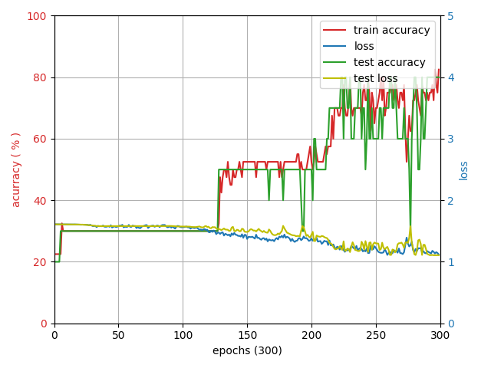
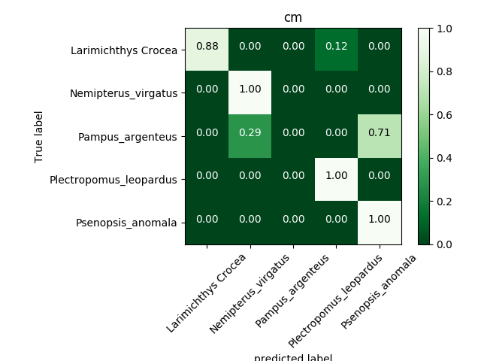
Original training results with normal cnn
Accuracy only 80%

Slide 10
small changes in the model (cnn)
Add another fully connected layer
layer | number of kernels | size | stride | padding | activation | dropout
Input | 400x400x3
conv1 | 32 | 5x5 | 1x1 | 2x2 | ReLU
maxpool1 |  | 5x5 | 5x5 | 1x1
conv2 | 64 | 5x5 | 1x1 | 2x2 | ReLU
maxpool2 |  | 5x5 | 5x5 | 1x1
conv3 | 32 | 5x5 | 1x1 | 2x2 | ReLU
maxpool3 |  | 5x5 | 5x5 | 1x1
flatten
dence1 |  | 2048 |  |  | ReLU | 0.2
dence2 |  | 5 |  |  | softmax
layer | number of kernels | size | stride | padding | activation | dropout
 | 400x400x3
conv1 | 32 | 5x5 | 1x1 | 2x2 | ReLU
maxpool1 |  | 5x5 | 5x5 | 1x1
conv2 | 64 | 5x5 | 1x1 | 2x2 | ReLU
maxpool2 |  | 5x5 | 5x5 | 1x1
conv3 | 32 | 5x5 | 1x1 | 2x2 | ReLU
maxpool3 |  | 5x5 | 5x5 | 1x1
flatten
dence1 |  | 2048 |  |  | ReLU | 0.2
dence2 |  | 2048 |  |  | ReLU | 0.2
dence3 |  | 5 |  |  | softmax

Slide 11
More photos
Went to 濱江魚市場 for more photos
To extend the dataset

Slide 12
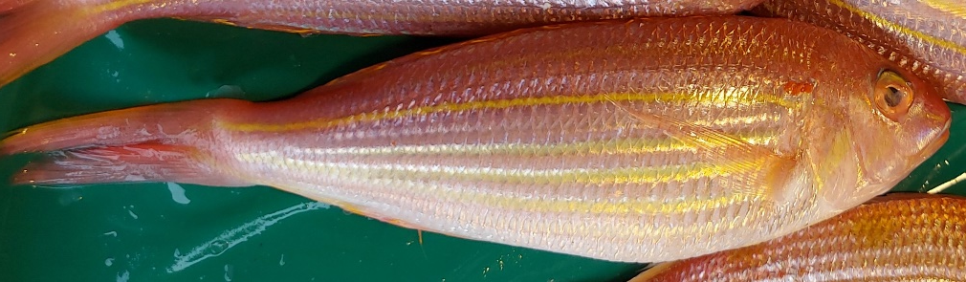
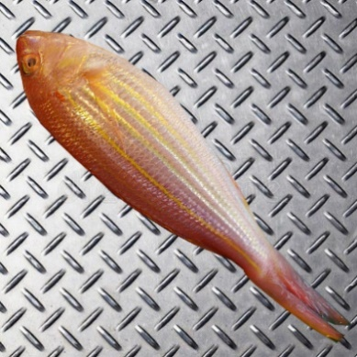
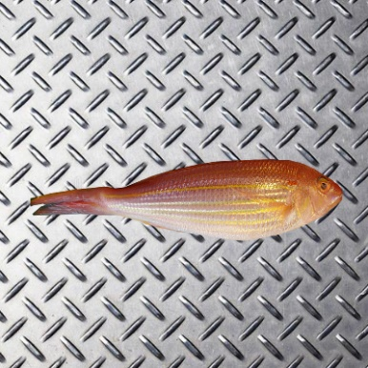
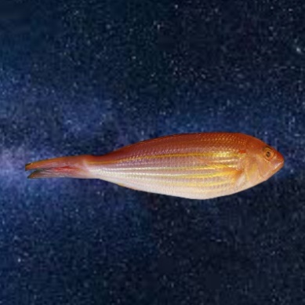
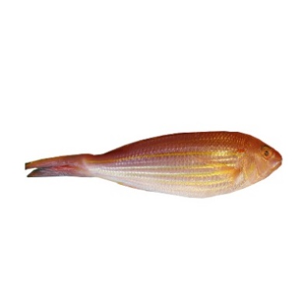
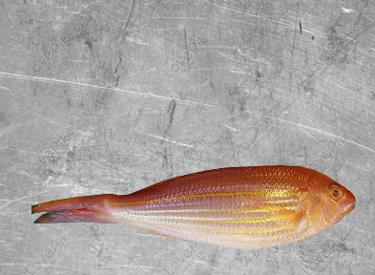
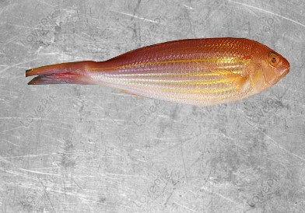
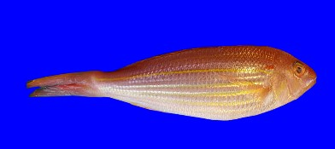
Manual data augmentation
With Photoshop
Same for every class
For different fishes of the same class
By rotation
By background
Shape of the image
Position in the photo

Slide 13
Why?
Make sure that the network understand that the background is not important for its task
Also that the fishes of the same class are no always have the same form and shape

Slide 14

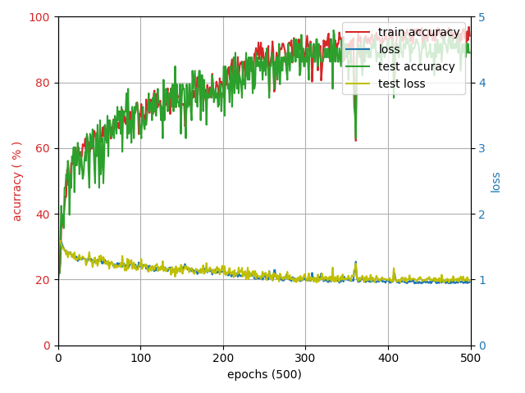
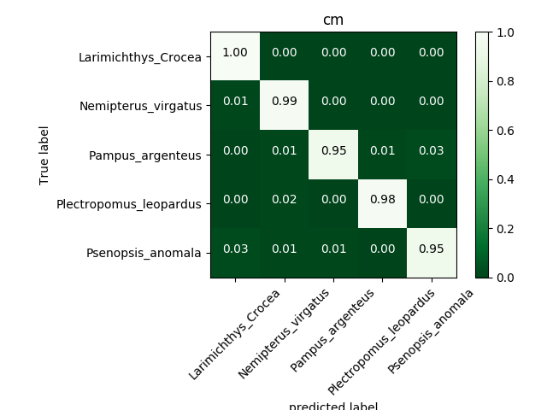
this week results with normal cnn
Accuracy : 97 %

Slide 15
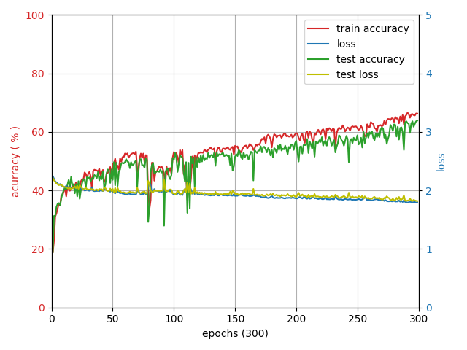
Other models (vgg19)
Not worth using

Slide 16
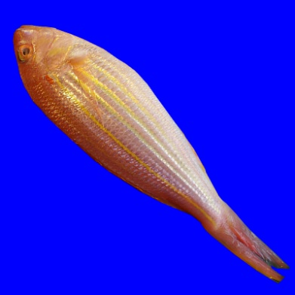
Automatic data augmentation
Add perspective
Add crop
Plus: Rotation, Flip

Slide 17
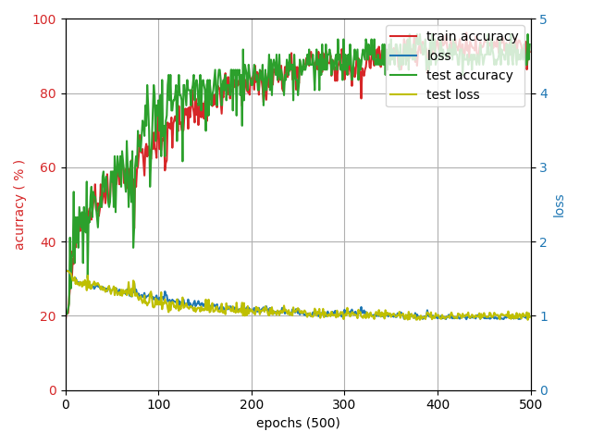

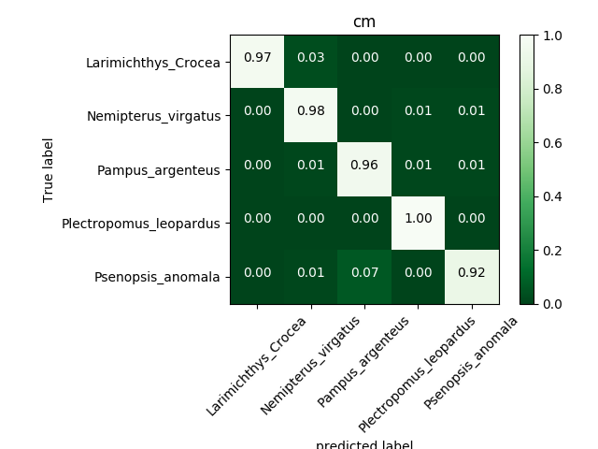
With this transformations
Accuracy : 96 %

Slide 18
Ready to work ?
Almost:
Still need more data to make sure it was not overfeat
However : it work with new data, not used for test no train
Also:
When doing the manual data augmentation there are classes that was no done properly. Which may affect the final result
Make it more robust

Slide 19
進度規劃
十月底-完成擷取魚的位置功能
十一月初-在樹莓派上測試、調整神經網路架構及參數
十一月中-開始製作專題海報

